Slide 1
Managing Modeling Content

Slide 2
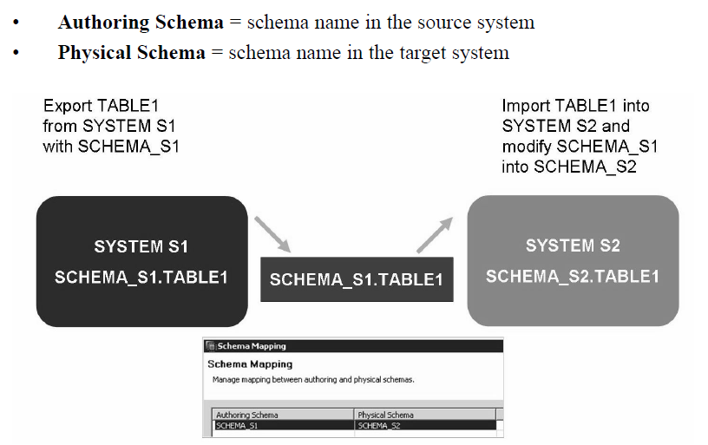
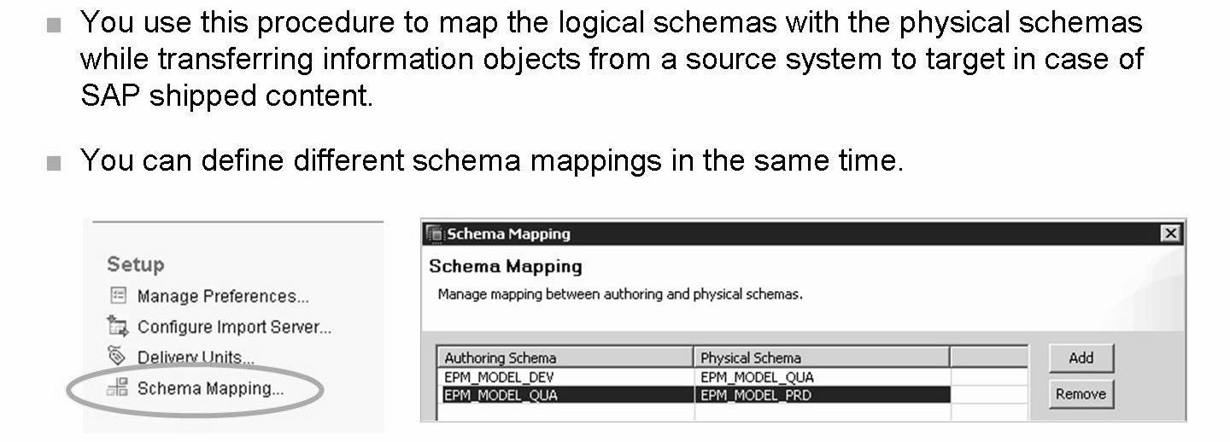
Schema Mapping

Slide 3
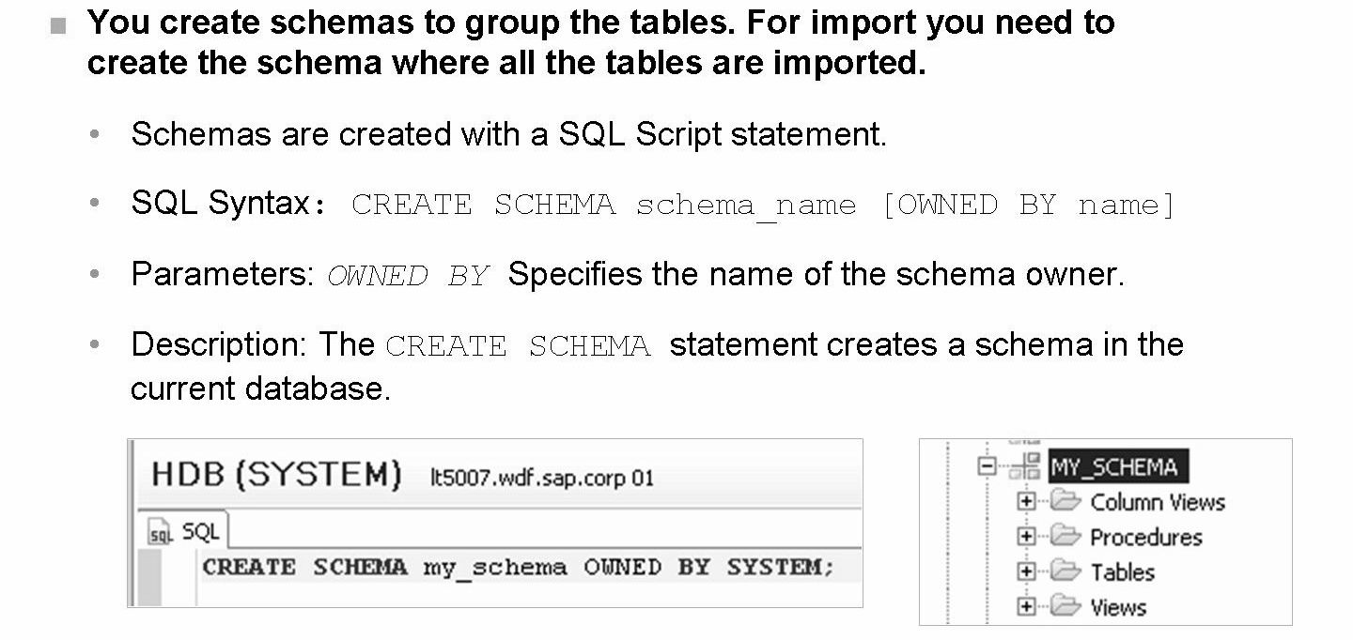
Creating Schemas
An administrator will normally maintain the Schema Mapping in the target system,
before importing the Information Model.
If the target Schema is not yet created in the target system, you can create it with the
CREATE SCHEMA statement.

Slide 4
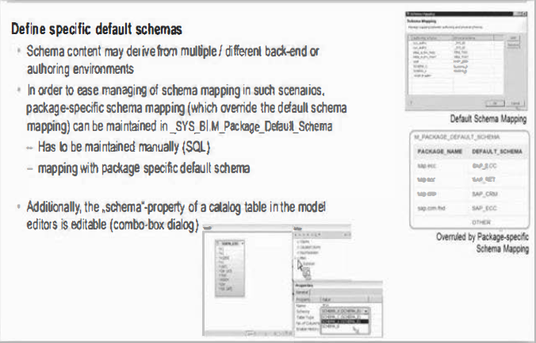
Mapping enhancement

Slide 5
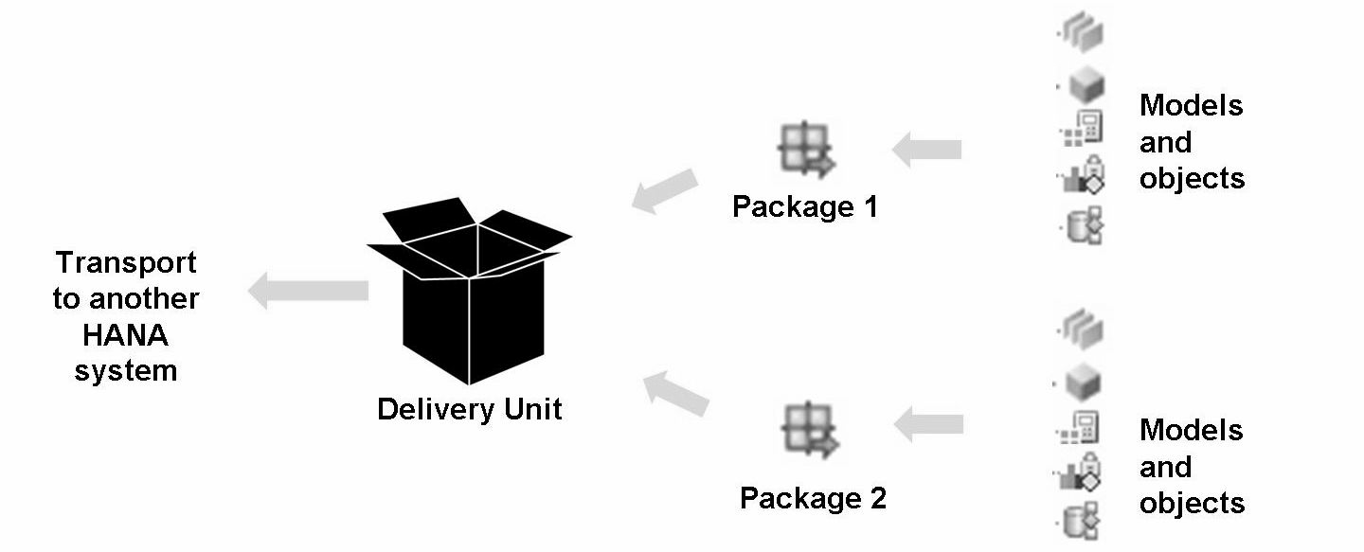
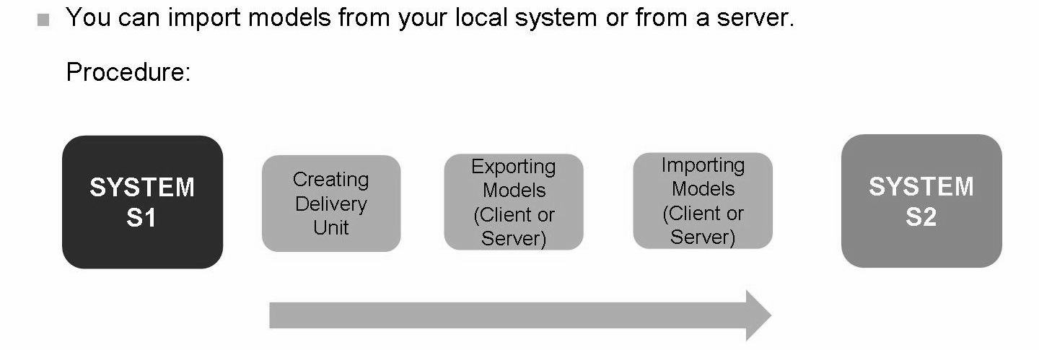
Exporting and Importing Information Models

Slide 6
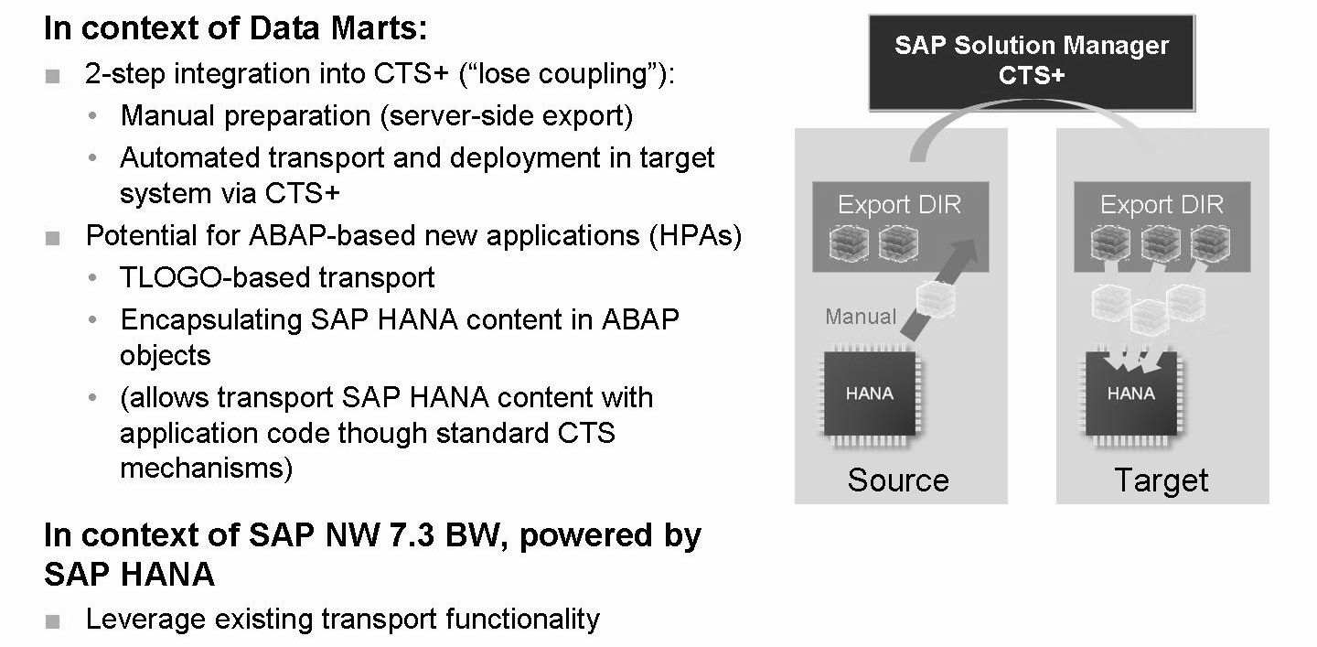
HANA Content Transport Capabilities
CTS = Change and Transport System
HPA = HANA-Powered Applications

Slide 7
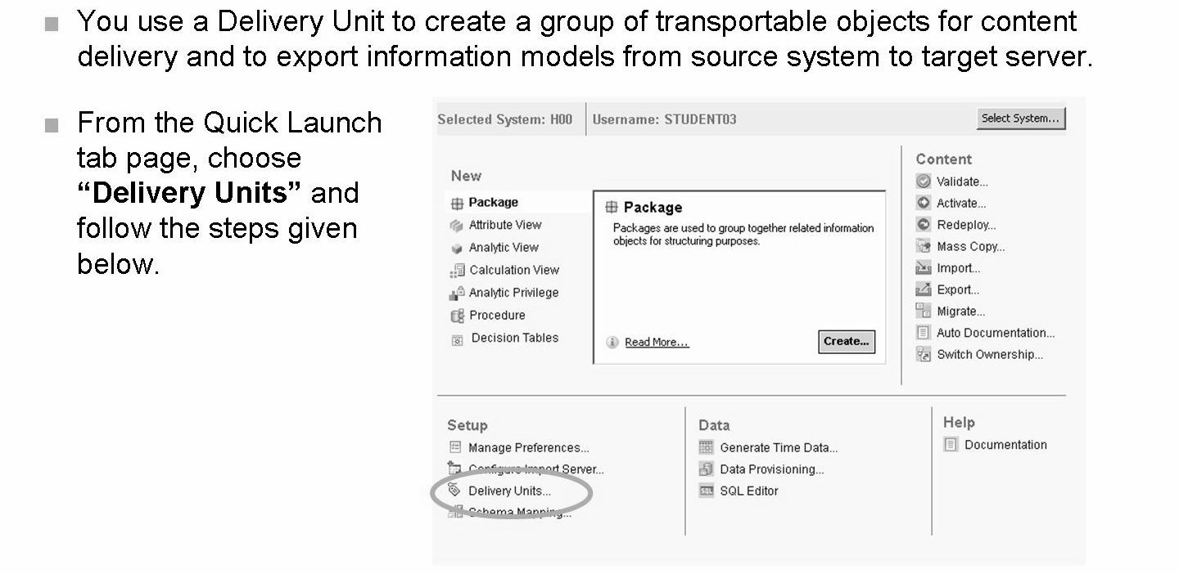
Delivery Units

Slide 8
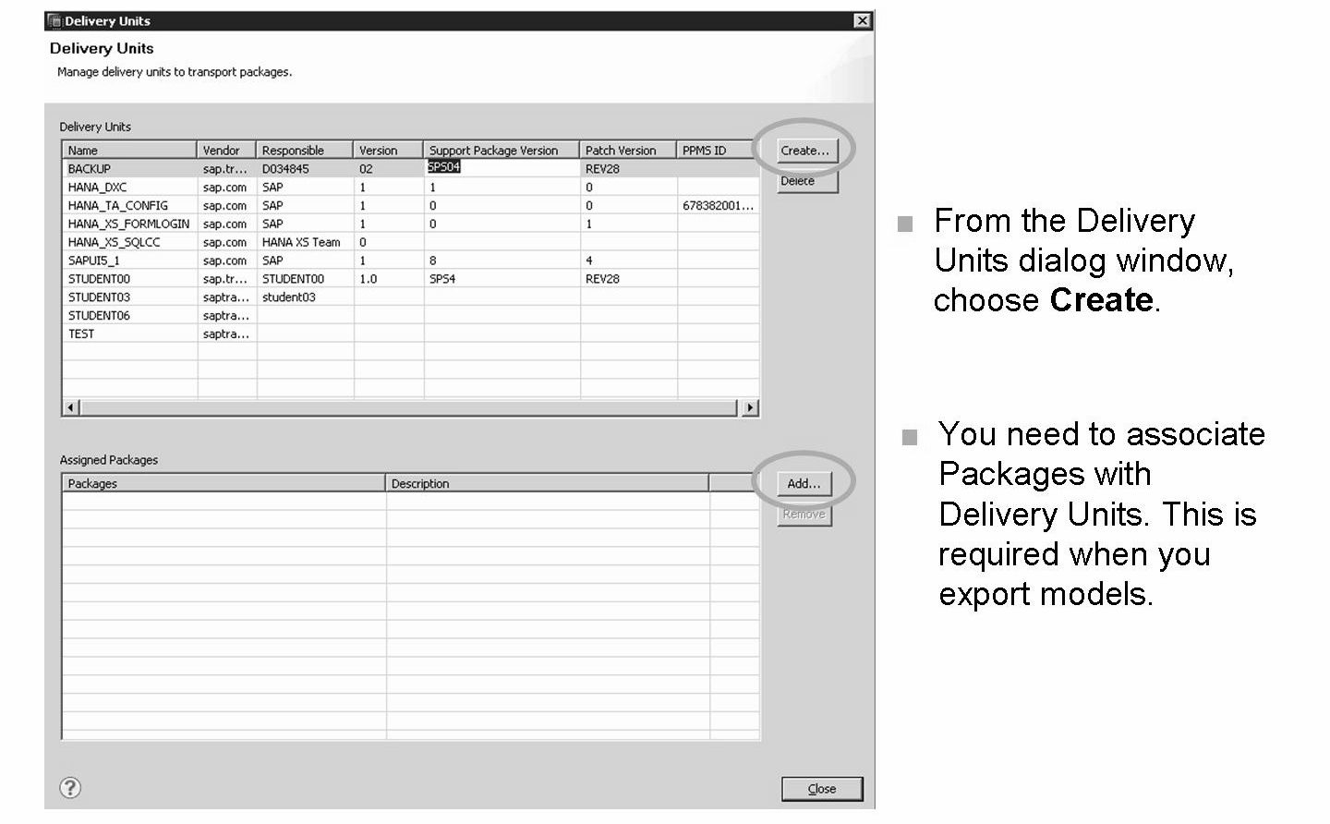

Slide 9
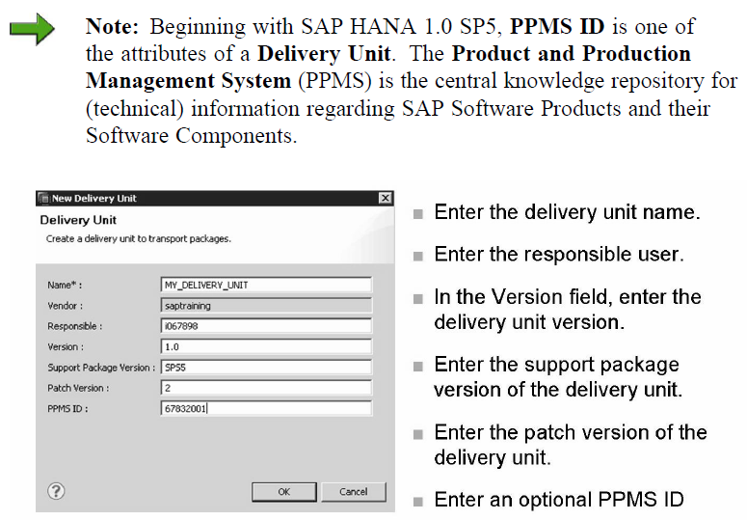

Slide 10
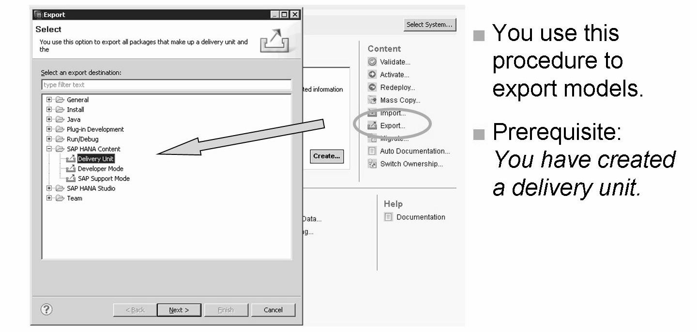
Export Model to Server

Slide 11
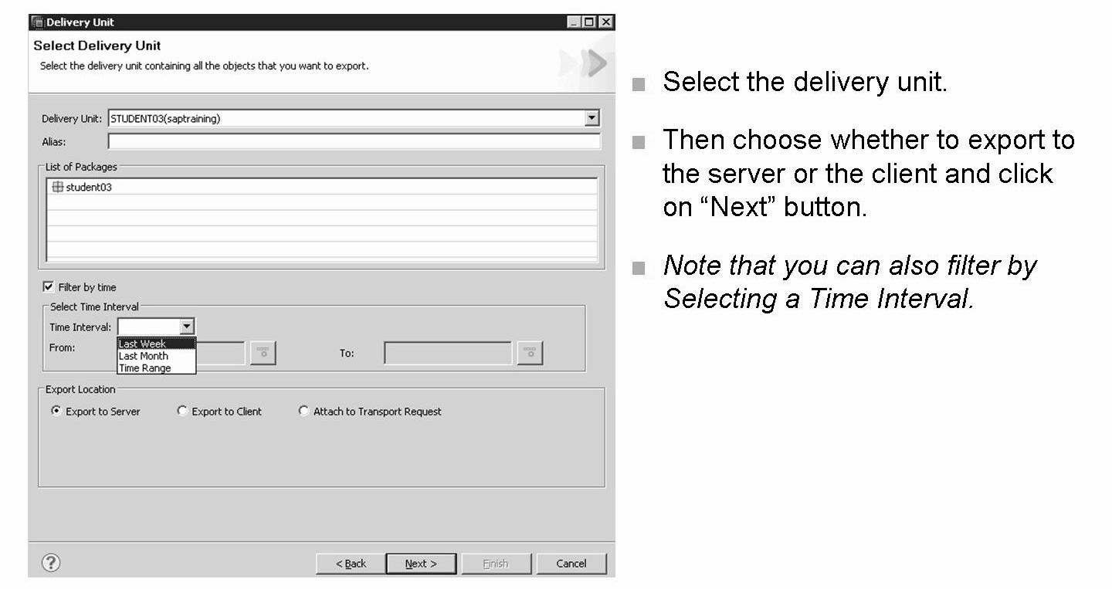
Export Model to Server
A careful approach is needed with the Filter By Time option to avoid serious object
consistency problems.
It is a general best practice to periodically schedule full exports, and have only a few exports using Filter By Time in between. When using Filter By Time, it is recommended to use a From date that corresponds to the date of the last full export.

Slide 12
Exporting objects using Delivery Units:
Function to export all packages that make up a Delivery Unit and the relevant objects contained therein, to the client or to the SAP HANA server file system.
Exporting objects using Developer mode:
Function to export individual objects to a directory on your client computer.
This mode of export should only be used in exceptional cases, since this does not cover all aspects of an object, for example, translatable texts are not copied.
Importing objects using Delivery Unit:
Function to import objects (grouped into a Delivery Unit) from the server or client location available in the form of .tgz file.
Importing objects using Developer mode:
Function to import objects from a client location to your SAP HANA modeling environment.

Slide 13
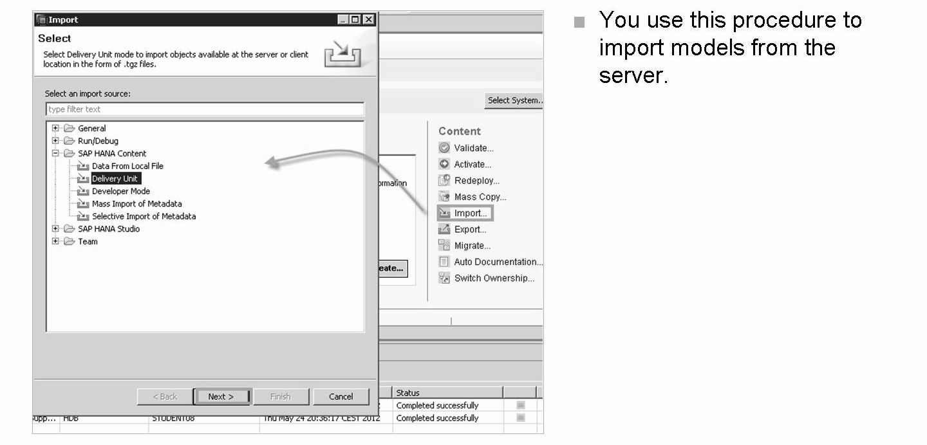
Import Model from Server

Slide 14
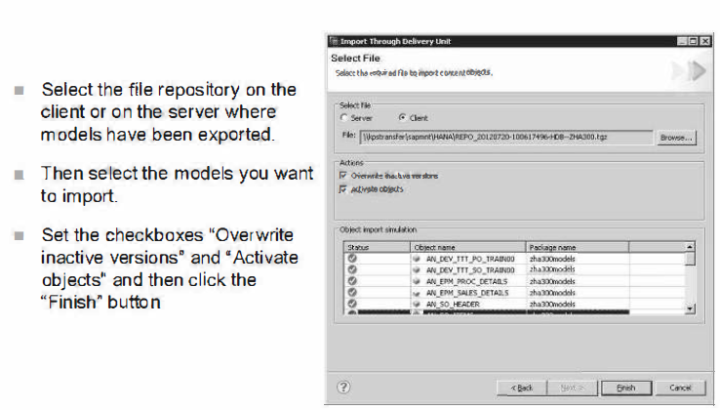
To overwrite inactive objects in the target system, select the option Overwrite inactive versions.
To activate objects in the target system, select the option Activate Objects .
The status of import can be viewed in Job log .
If you want to activate the imported objects, you need to grant SELECT privileges to user _SYS_REPO.

Slide 15
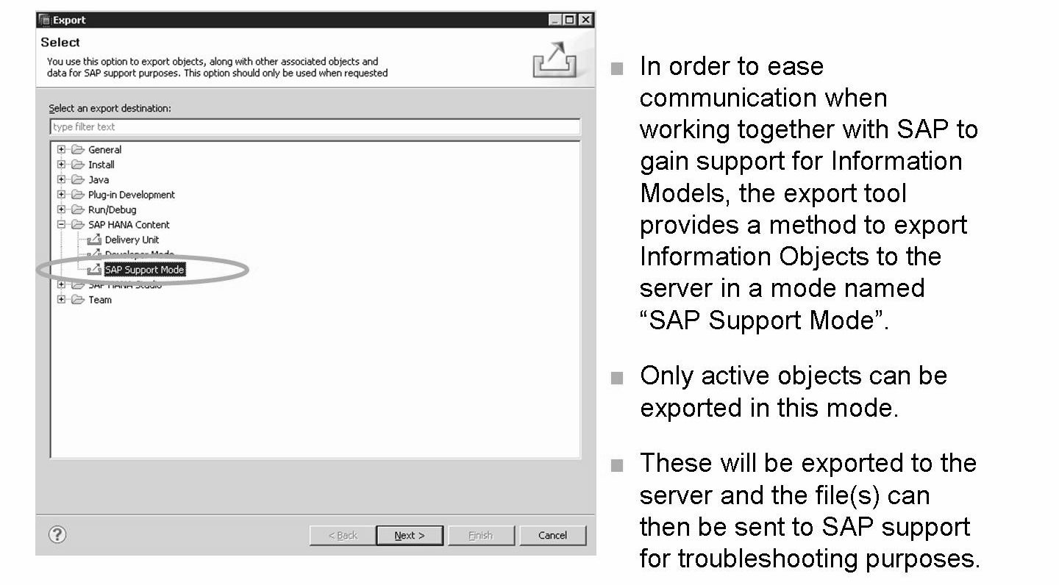
SAP Support Mode

Slide 16
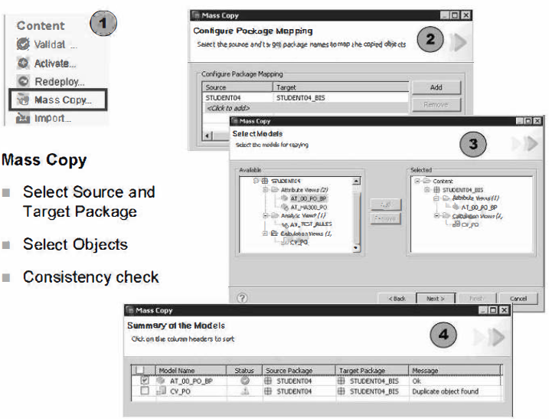
Copying Content Delivered by SAP

Slide 17
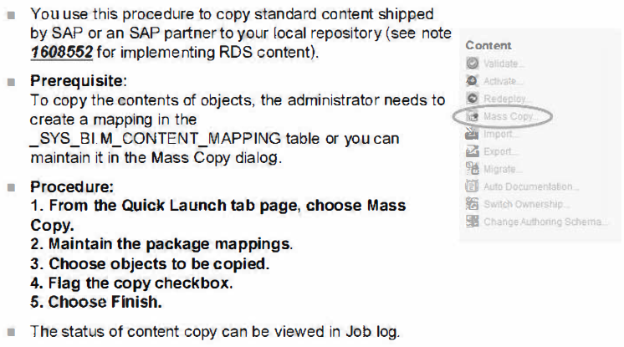
To copy the content, you must have the following privileges:
• REPO.READ on the source package
• REPO.MAINTAIN_NATJVE_PACKAGES on the Root Package
• REPO.EDIT_NATIVE_ OBJECTS on the Root Package

Slide 18
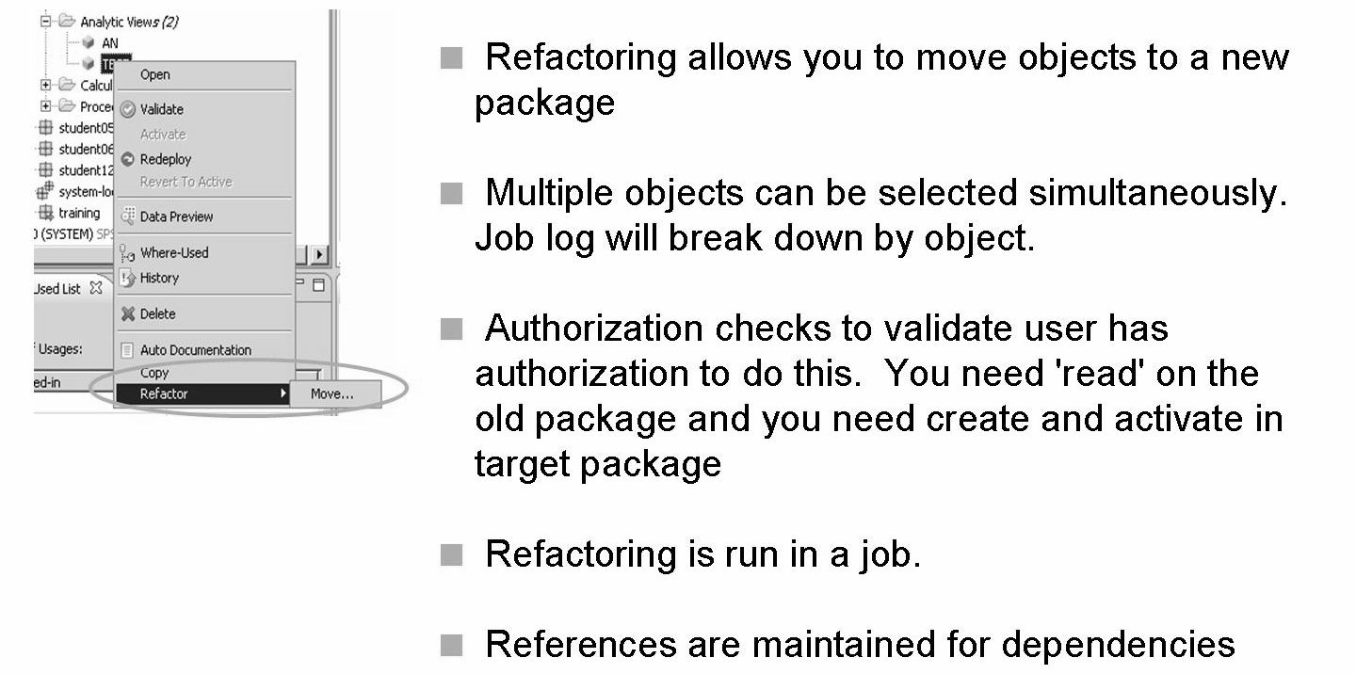
Refactoring - Moving Information Models between Packages

Slide 19
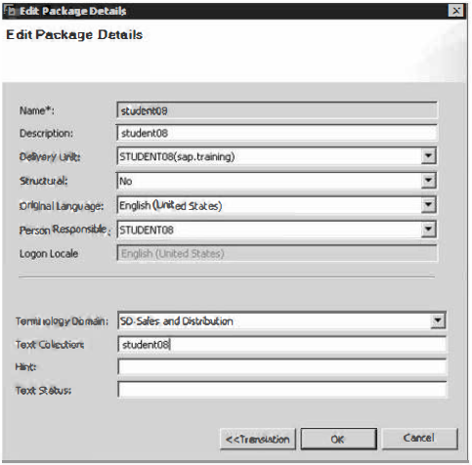
Translating Metadata Texts

Slide 20
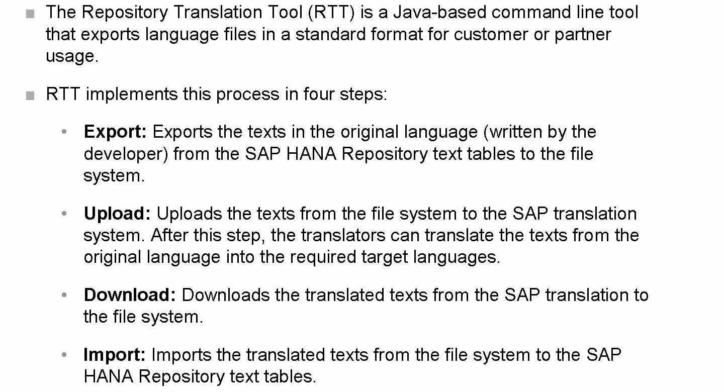
Repository Translation Tool (RTT)

Slide 21
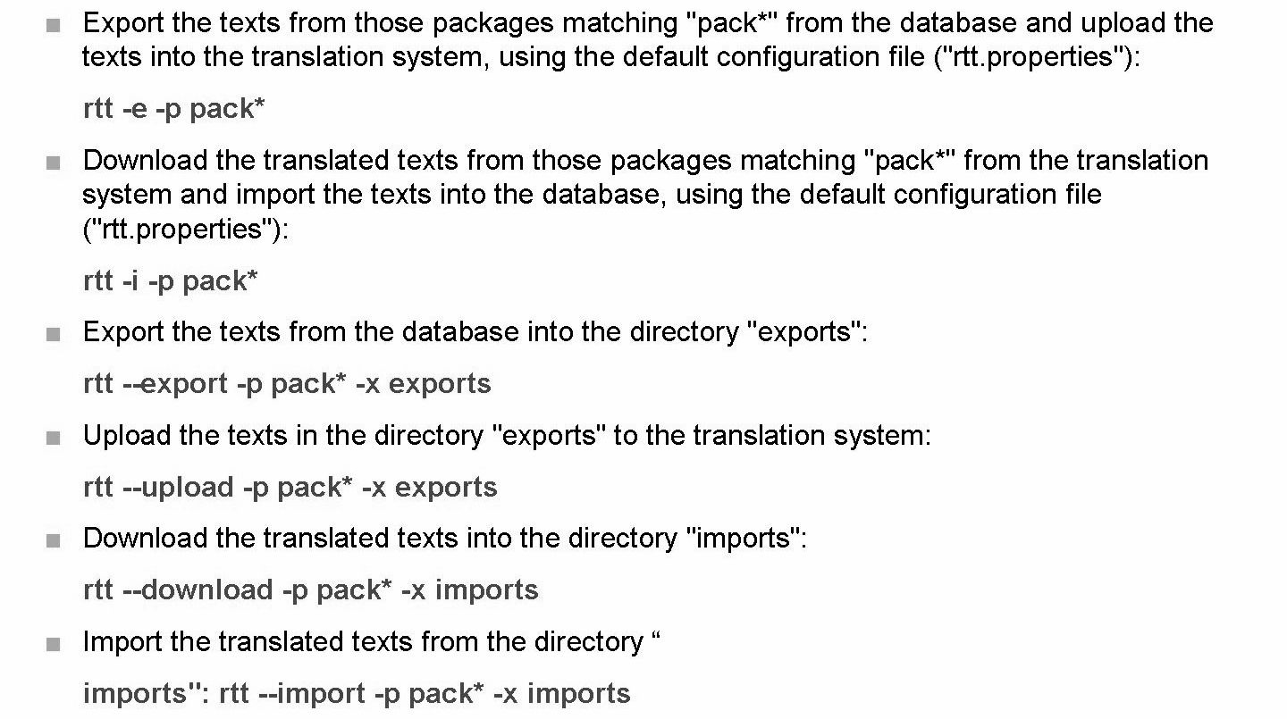
RTT Usage examples

Slide 22
THANK YOU
Courtesy : SAP Labs Document -
HA 300 – SAP HANA Implementation and Modeling

